Slide 1
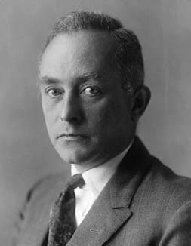
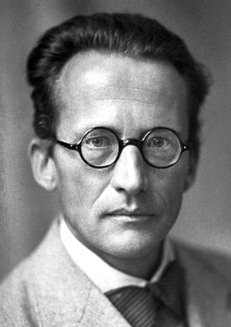
Recap Till Now:
Born Interpretation
ψ(x,y,z,t)?
Concepts of Operators
Ψ*Ψ is the
probability density
Schrodinger’s philosophy
Emmergence of
Quantization
(n)
A particle in box (1-3D)
QM Rules
Properties of Ψ
Ψ(r,θ,φ,) : 3 Quantum #s
n, l, m
1 e- Ψ(r,θ,φ,) : Orbital
Ψ² = electron density
Many Electron systems
(imp. of approx^{n})
Hydrogen Atom
?
Degeneracy of orbitals
Ψ(r,θ,φ,) . α/β)
e- Spin (4th QN)

Slide 2
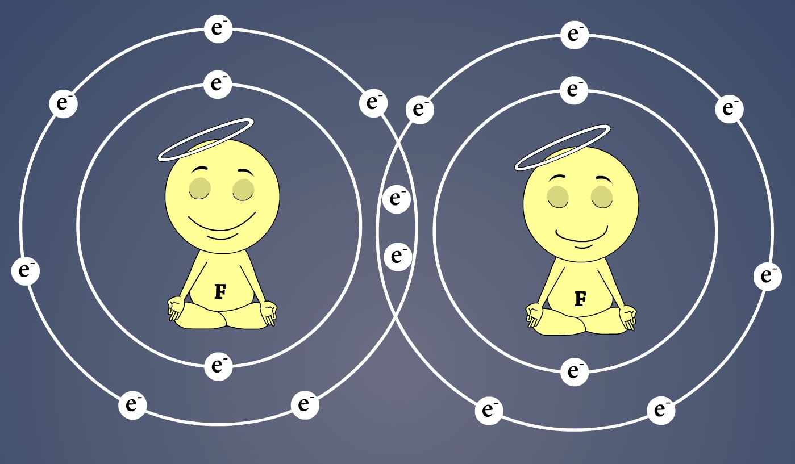
Lecture 14: Chemical Bonding: Dihydrogen molecule and ion

Slide 3
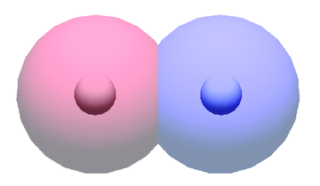
Stabilization due to Bond-formation
E(4 charges @ ∞) - E(2 H-Atoms) = ~ 2642 kJ/mole
E(2 H-Atoms @ ∞) - E(H₂ molecule) = ~ 436 kJ/mole
→ Chemical bond lowers the total energy by only ~17%
Charge distribution in H₂ molecule not very different from
Superposition of the charge distribution of individual atoms

Slide 4
Simplest Molecule: H₂⁺ - 1electron
2 Nuclei + 1 Electron
r_{1B}
r_{1A}
R
H₂⁺ Molecule Ion Exists, Stable (Experimentally observed)
Bond length ~ 1Å (2a₀) ; Bond Energy ~ 270 kJ/mole (0.1E_{H})
One more electron complicate matters to great extent!
Just like many electron atoms – So, we need to build a
Model with H₂⁺ and get insight into chemical bonding
Then extend model for other multi-electronic molecules

Slide 5
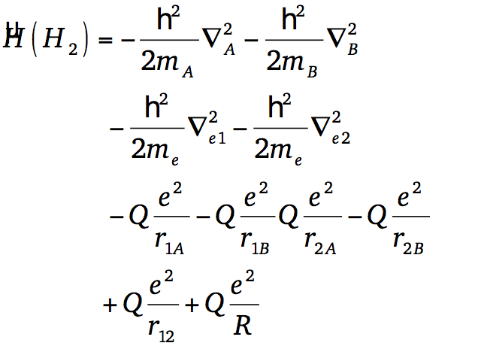
Bonding: H₂⁺ and H₂ molecules
-
e⁻
r_{A}
r_{B}
r
+
+
R
H_{A}
H_{B}
-
e⁻
r_{1A}
r_{1B}
r₁
H_{A}
+
+
H_{B}
r₂
R
r_{2A}
r_{2B}
e⁻
-

Slide 6
Born-Oppenheimer Approximation
Nuclei are stationary wrt electronic motion
CONSTANT
-
e⁻
r_{A}
r_{B}
r
+
+
R
TISE for H₂⁺
H_{A}
H_{B}
Very difficult, but possible to solve TISE under elliptical
polar coordinates at one R. Solve for energy at various R

Slide 7
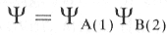
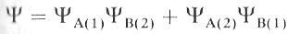
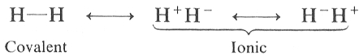
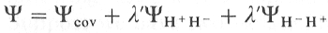
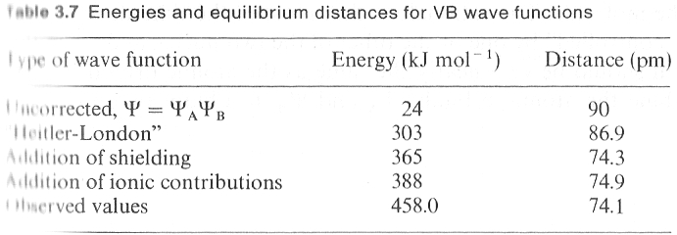
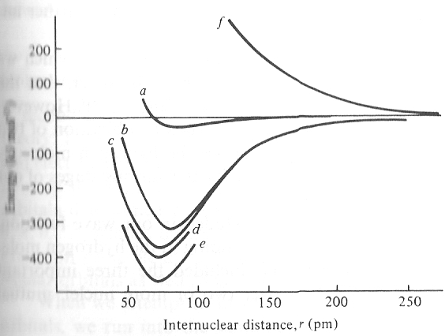
Guessing the wavefuntion: Model 1: Valence Bond Theory (VBT)
1st electron in H1
2nd electron in H2
Inclusion of ionic terms
“Resonance”

Slide 8
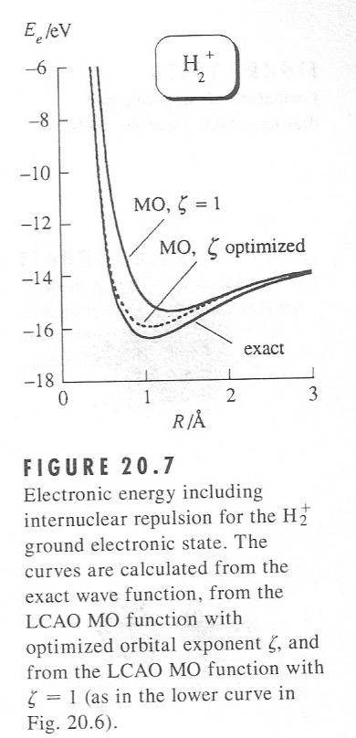
Model 2: Molecular Orbital Theory
Molecular Orbital (MO) is a 1-e w-function like Atomic Orbital (AO)
MO: Polycentric 1-electron function: spreads through the molecule
MO generated by Linear Combination of Atomic Orbitals (LCAO)
-
e⁻
H₂⁺
r_{A}
r_{B}
r
+
+
R
H_{A}
H_{B}
Linear Combination of Atomic Orbitals (LCAO)
LCAO-MO:
Each LCAO-MO: Function of One electronic coordinate
Both VBT and MOT are used frequently – each of
them work good for certain systems, respectively,
and often are not so good for other systems!

Slide 9
Stabilization due to Bond-formation
E(4 charges @ ∞) - E(2 H-Atoms) = ~ 2642 kJ/mole
E(2 H-Atoms @ ∞) - E(H₂ molecule) = ~ 436 kJ/mole
→ Chemical bond lowers the total energy by only ~17%
Charge distribution in H₂ molecule not very different from
Superposition of the charge distribution of individual atoms

Slide 10
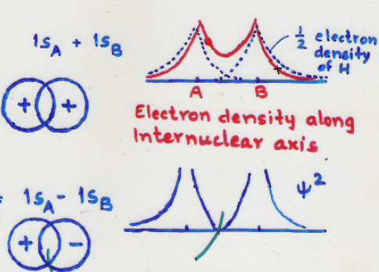
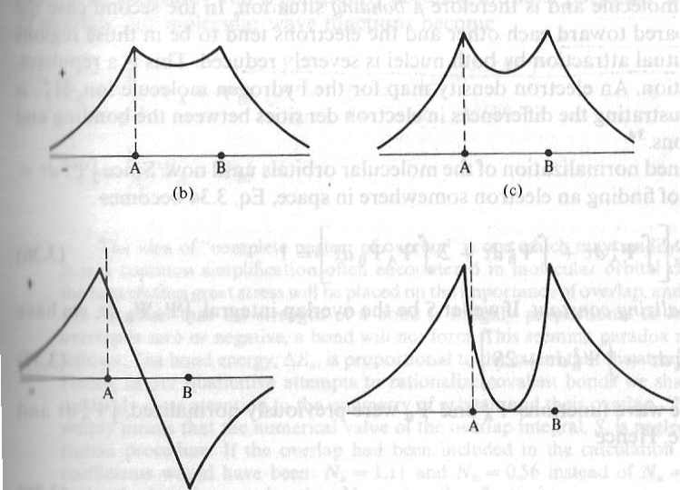
Molecular Orbital Theory- H2⁺
Linear Combination of Atomic Orbitals (LCAO)
Charge distribution in H₂ molecule not very different from
Superposition of the charge distribution of individual atoms
φ₊²
φ₊
φ₋²
φ ₋

Slide 11




Slide 12
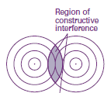

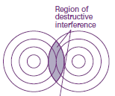

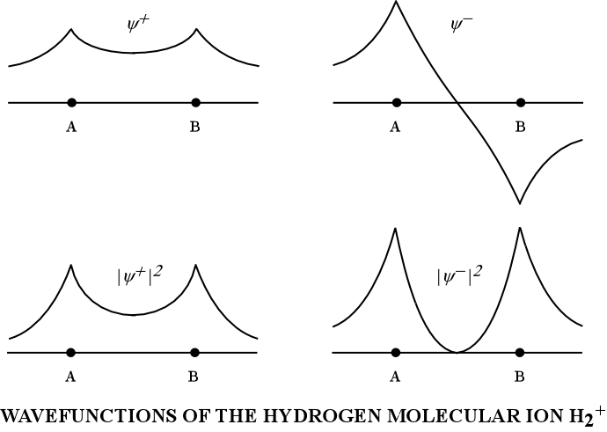
Molecular Orbital Theory- H2⁺

Slide 13
Normalization of Molecular Orbitals
1
Same integral
1

Slide 14
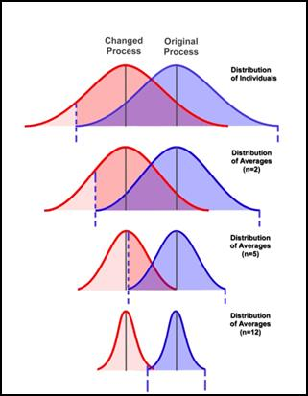
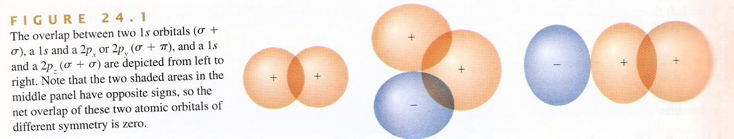
Concept of Overlap Integral
P_{X/Y} +s
Z-axis
P_{Z} + s
Overlapped area
of 2 Wave- functions (can have +/- values)
Have to consider
extent (amount)
of both positive
and negative
contributions!
1s+1s
S>0
S=0
S>0 or <0?
→S is a qualitative measure of bond strength
→If S>>0; electron delocalized over molecule
→S(R) = 0 ➔ bond formation cannot occur

Slide 15
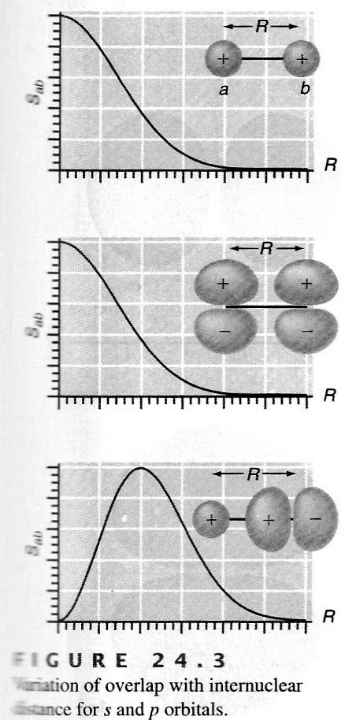
Overlap Integral depends on R_{AB}
1s+1s
2p_{z}+1s
2p_{x}+2p_{x}
(lateral)

Slide 16
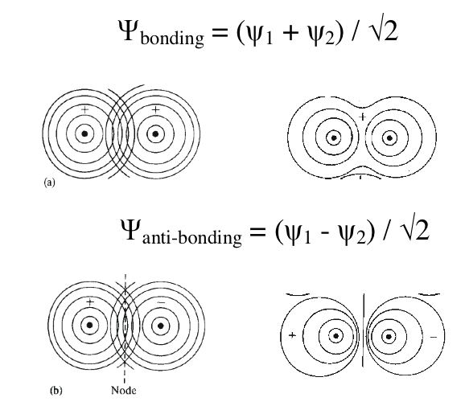
Molecular Orbital Theory- H2⁺

Slide 17
Molecular Orbital Theory- H2⁺

Slide 18
Molecular Orbital Theory- H2⁺

Slide 19
Molecular Orbital Theory- H2⁺

Slide 20
Molecular Orbital Theory- H2⁺
Ĥ is Hermitian

Slide 21
Molecular Orbital Theory- H2⁺

Slide 22
Molecular Orbital Theory of H₂⁺ : H_{ii}
Constant at fixed internuclear distance
J ⇒ Coulomb Integral
J ⇒ Interaction E of the e- (-) charge cloud with the + nucleus at some distance

Slide 23
Molecular Orbital Theory of H₂⁺ : H_{ij}
Constant
//
//
//
//v
//v
//v
//v
//
//v
K is purely a quantum mechanical concept. There is no classical counterpart
K ⇒ Exchange Integral
Resonance Integral

Slide 24
Molecular Orbital Theory- H2⁺

Slide 25
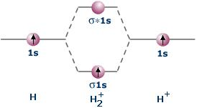
Molecular Orbital Theory- H2⁺

Slide 26
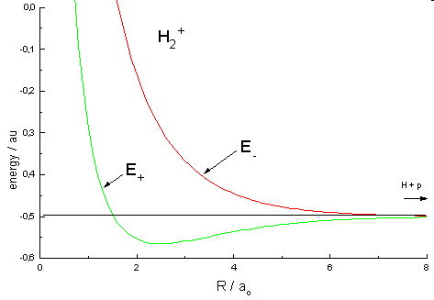
Bonding/Antibonding energy is f(R_{AB})
H₂⁺
S = f(R_{AB})
H_{ii} = H_{ii}(R_{AB})
H_{ij} = H_{ij}(R_{AB})
Energy = E(R_{AB})
Calculate energies as a function
Of internuclear separation, R_{AB}:
A bound state and an unbound state
Textbook pictures: Represents
energies of bonding and anti-bonding
levels at equilibrium R_{AB}

Slide 27
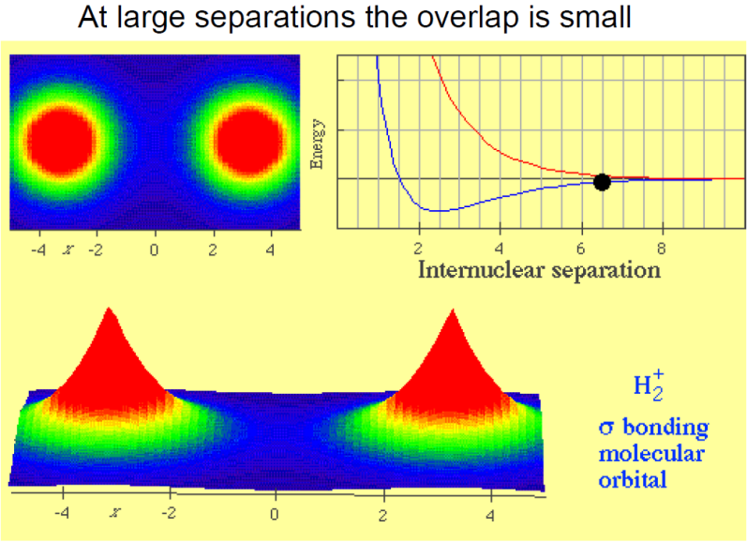
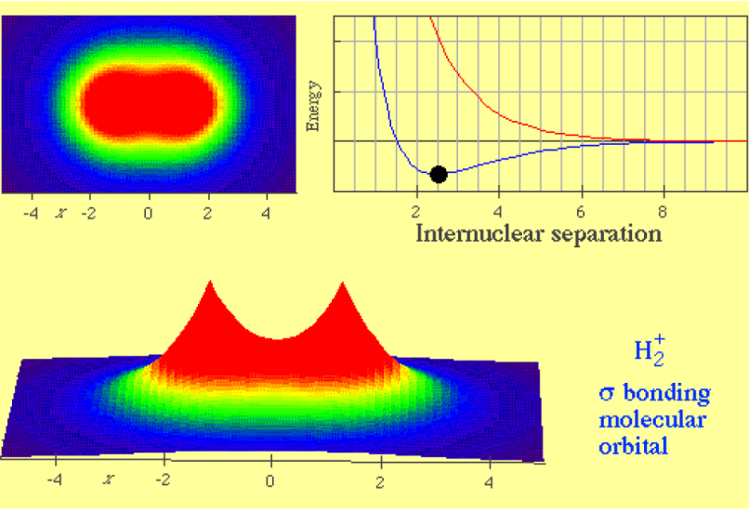
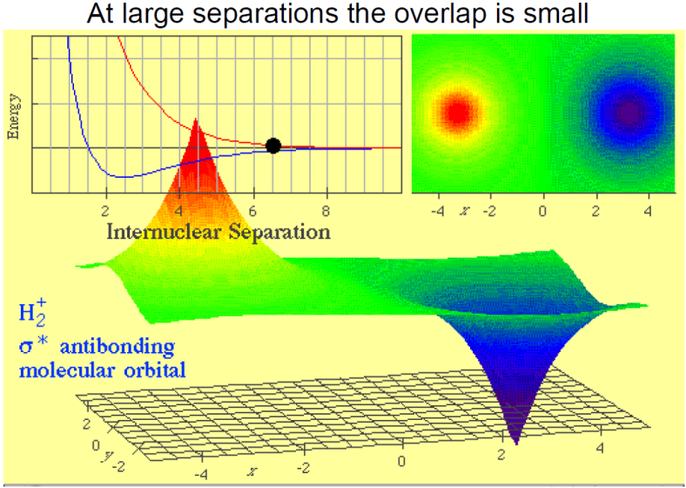
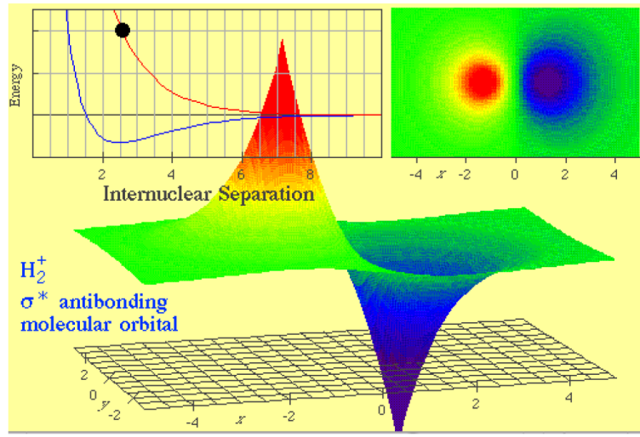
Electron Densities and Energy: f(R_{AB})

